Slide 2
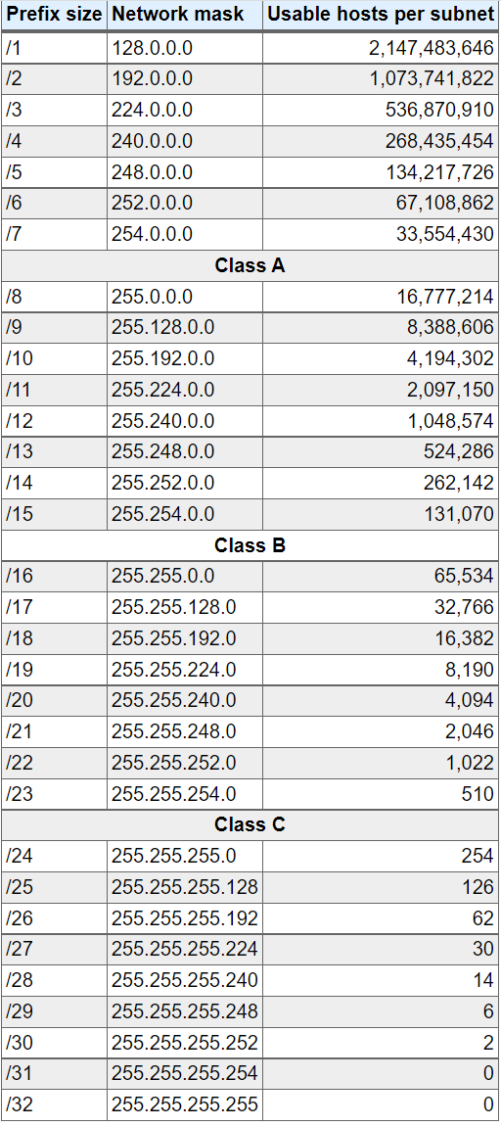
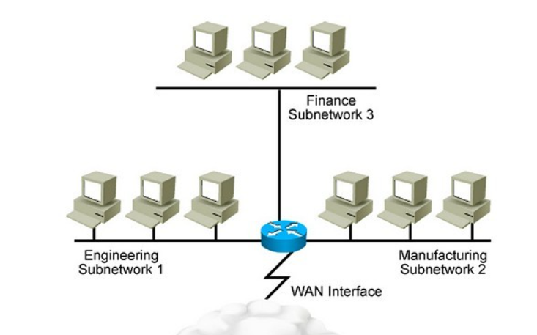
Basic Networking
10.0.1.0/24
10.0.3.0/24
10.0.2.0/24
AWS Networking
129.110.242.32

Slide 3
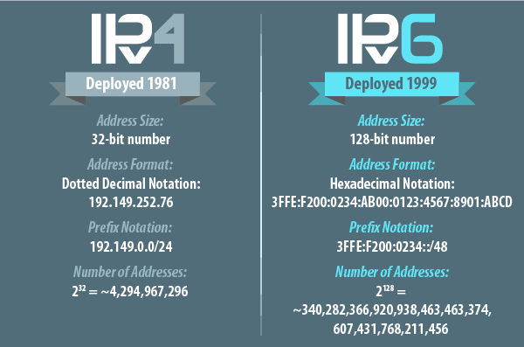
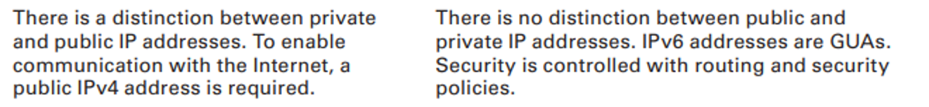
Basic Networking
Required
Optional

Slide 4
Cloud Networking components:
Subnets
Route Tables
IP Addressing
Security Groups
Network Access Control Lists (ACLs)
Internet Gateways
Network Address Translation (NAT) Instances and NAT Gateways
Egress Only Internet Gateways (EIGWs)
Virtual Private Gateways (VGWs),
Customer Gateways,
Virtual Private Networks (VPNs)
Direct Connect
10. VPC Endpoints
11. VPC Peering
12. Placement Groups
13. Elastic Network Interfaces
14. Dynamic Host Configuration Protocol (DHCP) Option Sets
15. Amazon Domain Name Service (DNS) Server
16. VPC Flow Logs

Slide 5
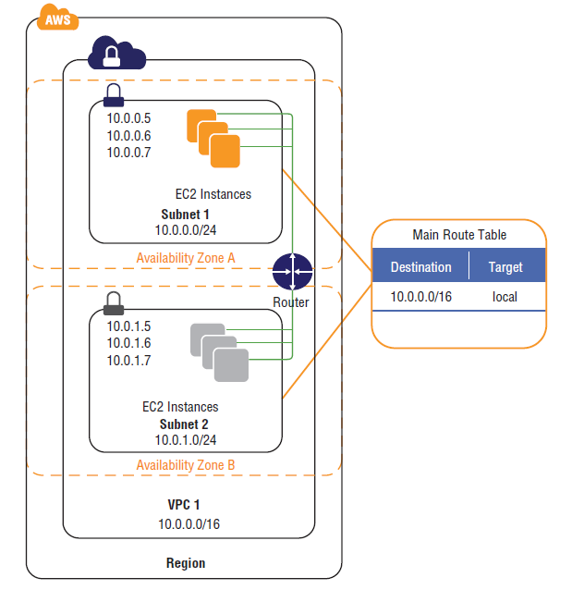
Amazon VPC ( Virtual Private Cloud)
Virtual private cloud (VPC) is a virtual network dedicated to your AWS account.
Analogous to having your own Data Centre (DC) inside AWS.
It is logically isolated from other virtual networks in the AWS Cloud.
Provides complete control over the virtual networking environment including selection of IP ranges, creation of subnets and configuration of route tables and gateways.
You can launch your AWS resources, such as Amazon EC2 instances, into your VPC.
When you create a VPC, you must specify a range of IPv4 addresses for the VPC in the form of a Classless Inter-Domain Routing (CIDR) block; e.g. 10.0.0.0/16. This is the primary CIDR block for your VPC.
A VPC spans all the Availability Zones in the region.
You can create your own IP address ranges, and create subnets, route tables and network gateways.
When you first create your AWS account a default VPC is created for you in each AWS region.
Notes:
IANA IPv4 Special-Purpose Address Registry
0.0.0.0/8 and /32
10.x.x.x
100.64.x.x
127.x.x.x
169.254.x.x
172.16.x.x
192.x.x.x
198.x.x.x
203.x.x.x
240.x.x.x
255.255.244.255/32

Slide 6
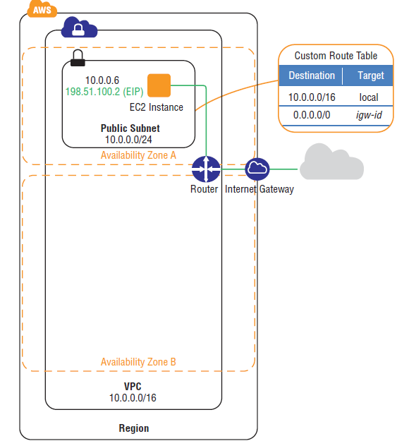
Amazon VPC ( Virtual Private Cloud)
A default VPC is created in each region with a subnet in each AZ.
By default, you can create up to 5 VPCs per region.
You can define dedicated tenancy for a VPC to ensure instances are launched on dedicated hardware (overrides the configuration specified at launch).
The default VPC has all-public subnets.
Public subnets are subnets that have:
“Auto-assign public IPv4 address”
The subnet route table has an attached Internet Gateway
Instances in the default VPC always have both a public and private IP address.

Slide 7
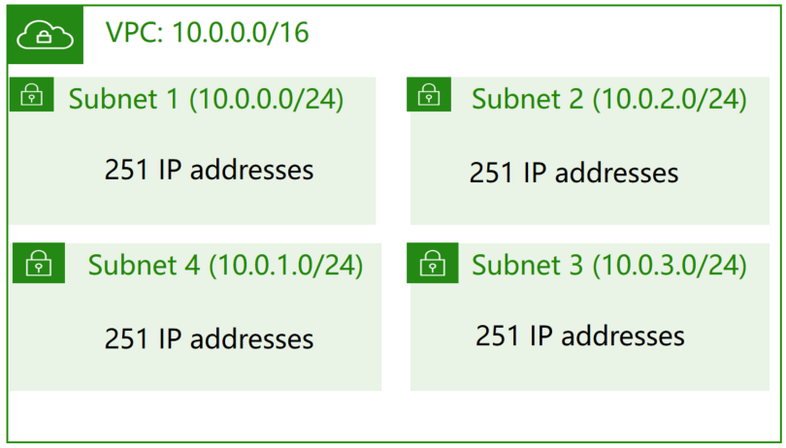
1. Subnets
VPC spans all Availability Zones in a region, a subnet cannot span more than one Availability Zone. You may create zero, one, or more subnets in each Availability Zone
Within Amazon VPC, broadcast and multicast traffic is not forwarded. Subnets can be as large as you like without impacting performance and traffic forwarding.
If you disassociate an IPv6 CIDR from your VPC, you cannot expect to receive the same CIDR if you subsequently request an IPv6 block from Amazon.
While subnets are often referred to as “public” or “private” in AWS documentation, their underlying capabilities are the same. The defining distinction between a private subnet and a public subnet is a route to an attached Internet gateway.
Each subnet has own route table*
IP Addresses for CIDR block 10.0.0.0/24 | Reserved for
10.0.0.0 | Network address
10.0.0.1 | Internal communication
10.0.0.2 | Domain Name System (DNS) resolution
10.0.0.3 | Future use
10.0.0.255 | Network broadcast address

Slide 8
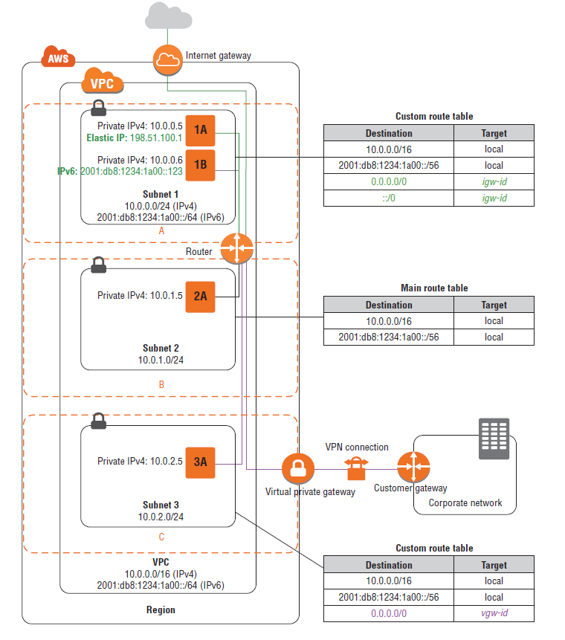
1. Subnets
Each subnet must reside entirely within one Availability Zone and cannot span zones.
Types of subnet:
• If a subnet’s traffic is routed to an internet gateway, the subnet is known as a public subnet.
• If a subnet doesn’t have a route to the internet gateway, the subnet is known as a private subnet.
• If a subnet doesn’t have a route to the internet gateway, but has its traffic routed to a virtual private gateway for a VPN connection, the subnet is known as a VPN-only subnet.
An Internet Gateway is a horizontally scaled, redundant, and highly available VPC component that allows communication between instances in your VPC and the internet.

Slide 9
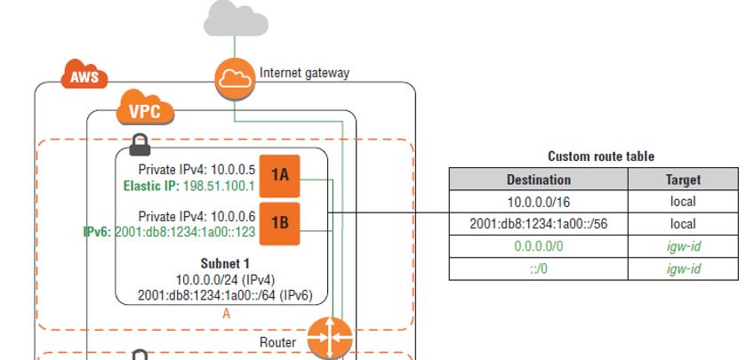
2. Route Tables
Your VPC has an implicit router.
Your VPC automatically comes with a main route table that you can modify.
You can create additional custom route tables for your VPC.
Each subnet is associated with a route table, which controls the routing for the subnet.
If you don’t explicitly associate a subnet with a particular route table, the subnet uses the main route table.
You can set a custom route table as the main route table so that new subnets are automatically associated with it.
Each route in a table specifies a destination CIDR and a target; for example, traffic destined for 172.16.0.0/12 is targeted for the VGW.
AWS uses a predefined route priority process to determine how to route the traffic

Slide 10
3. IP Addresses
Public IPv4 address
Manually assigned through an Elastic IP address
Automatically assigned through the auto-assign public IP address settings at the subnet level
You cannot manually disassociate the automatically-assigned public IP address from your instance after launch. It is automatically released in certain cases, for example when you stop or terminate your instance, after which you cannot reuse it.

Slide 11
3. IP Addresses
Elastic IP address
Associated with an AWS account and additional costs might apply
Can be allocated and remapped anytime. You can map Elastic IP addresses from one private IPv4 address to another, either in the same VPC or a different VPC, within the same region and account.
You must first allocate an Elastic IP address within a VPC and then assign it to an instance.
Elastic IP addresses are specific to a region.
There is a one-to-one relationship between private IPv4 addresses and Elastic IP addresses. Your instance will receive traffic destined to the private address mapping for your Elastic IP address.
Elastic IP addresses remain associated with your AWS account until you explicitly release them.

Slide 12
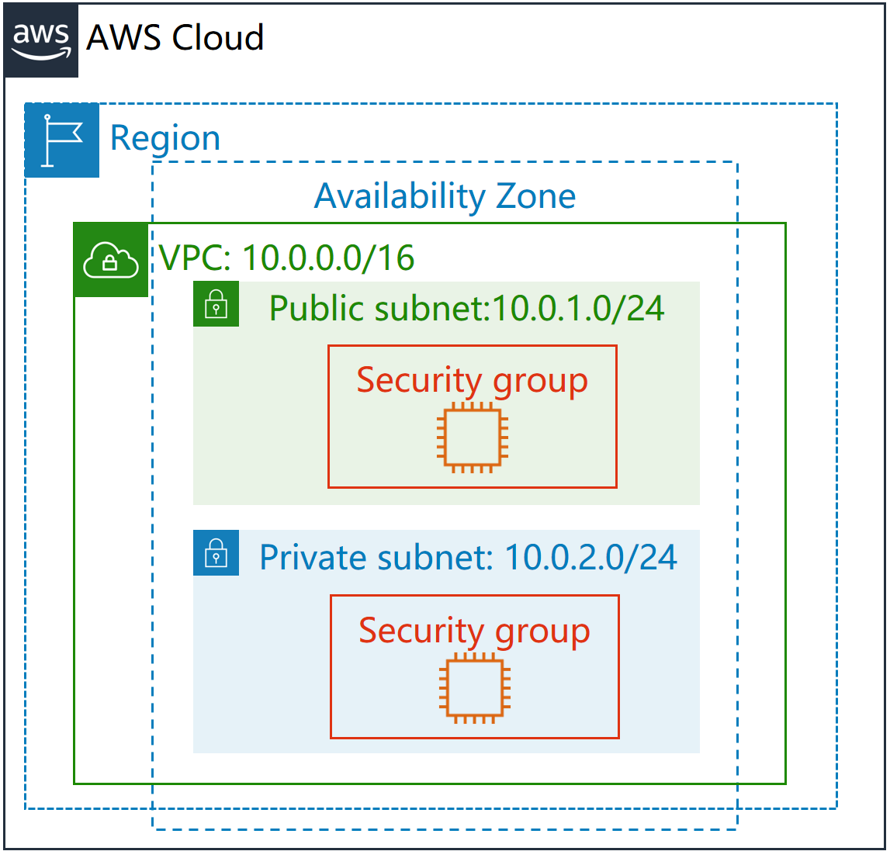
4. Security Groups
A security group is a stateful virtual firewall that controls inbound and outbound network traffic to AWS resources and Amazon EC2 instances.
All Amazon EC2 instances are launched with a security group. If a security group is not specified at launch, then the instance will be launched with the default security group for the VPC in which it is launched.
Default security group allows communication between all resources within the security group, and it allows all outbound traffic; all other traffic is denied implicitly.
You may change the rules for the default security group, but you may not delete the default security group.
You can specify allow rules, but not deny rules.
Notes:
The following are the characteristics of security group rules:
You can specify allow rules, but not deny rules.
When you first create a security group, it has no inbound rules. Therefore, no inbound traffic is allowed until you add inbound rules to the security group.
When you first create a security group, it has an outbound rule that allows all outbound traffic from the resource. You can remove the rule and add outbound rules that allow specific outbound traffic only. If your security group has no outbound rules, no outbound traffic is allowed.
When you associate multiple security groups with a resource, the rules from each security group are aggregated to form a single set of rules that are used to determine whether to allow access.
When you add, update, or remove rules, your changes are automatically applied to all resources associated with the security group. The effect of some rule changes can depend on how the traffic is tracked
When you create a security group rule, AWS assigns a unique ID to the rule. You can use the ID of a rule when you use the API or CLI to modify or delete the rule.

Slide 13
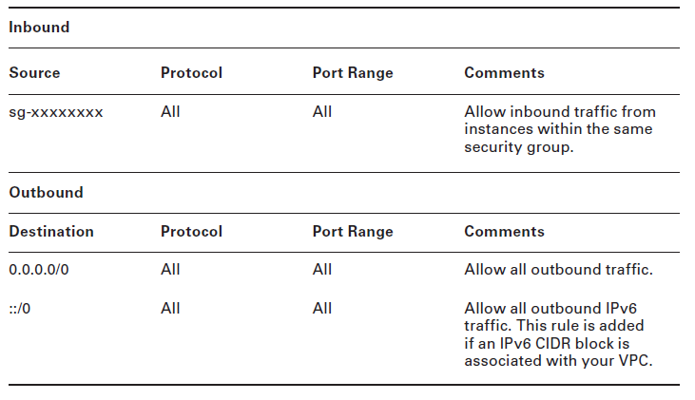
4. Security Groups

Slide 14
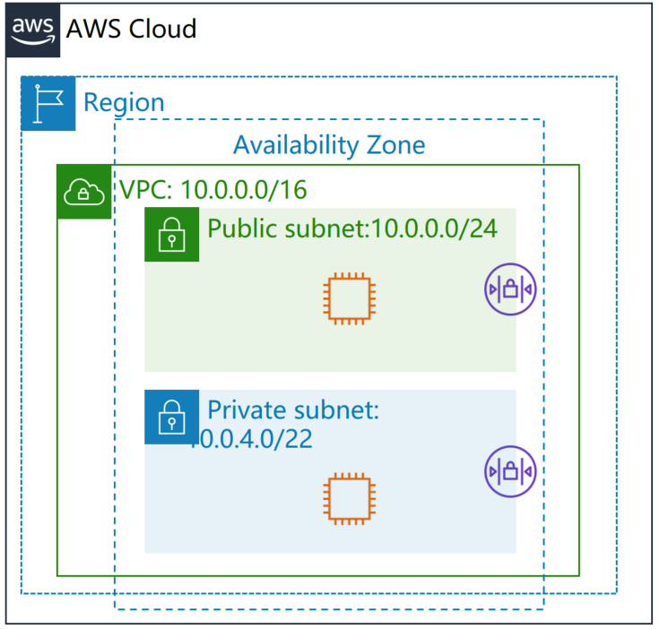
5. Network Access Control Lists (ACLs)
A network ACL is another optional layer of security that acts as a stateless firewall on a subnet level. A network
ACL is an ordered list of rules that AWS evaluates, starting with the lowest numbered rule, to determine whether traffic is allowed in or out of any subnet associated with the network ACL.
Each network ACL has a final deny all rule that you cannot change.
VPCs are created with a modifiable default network ACL associated with every subnet. The default network ACL allows all inbound and outbound traffic for IPv4. When
You create a custom network ACL, its initial configuration will deny all inbound and outbound traffic until you create rules that allow otherwise.
Every subnet must be associated with a network ACL. If you associate an IPv6 CIDR block with your VPC, Amazon automatically adds rules that allow all inbound and outbound IPv6 traffic.
Notes:
The following are the basic things that you need to know about network ACLs:
Your VPC automatically comes with a modifiable default network ACL. By default, it allows all inbound and outbound IPv4 traffic and, if applicable, IPv6 traffic.
You can create a custom network ACL and associate it with a subnet. By default, each custom network ACL denies all inbound and outbound traffic until you add rules.
Each subnet in your VPC must be associated with a network ACL. If you don't explicitly associate a subnet with a network ACL, the subnet is automatically associated with the default network ACL.
You can associate a network ACL with multiple subnets. However, a subnet can be associated with only one network ACL at a time. When you associate a network ACL with a subnet, the previous association is removed.
A network ACL contains a numbered list of rules. We evaluate the rules in order, starting with the lowest numbered rule, to determine whether traffic is allowed in or out of any subnet associated with the network ACL. The highest number that you can use for a rule is 32766. We recommend that you start by creating rules in increments (for example, increments of 10 or 100) so that you can insert new rules where you need to later on.
A network ACL has separate inbound and outbound rules, and each rule can either allow or deny traffic.
Network ACLs are stateless, which means that responses to allowed inbound traffic are subject to the rules for outbound traffic (and vice versa).

Slide 15
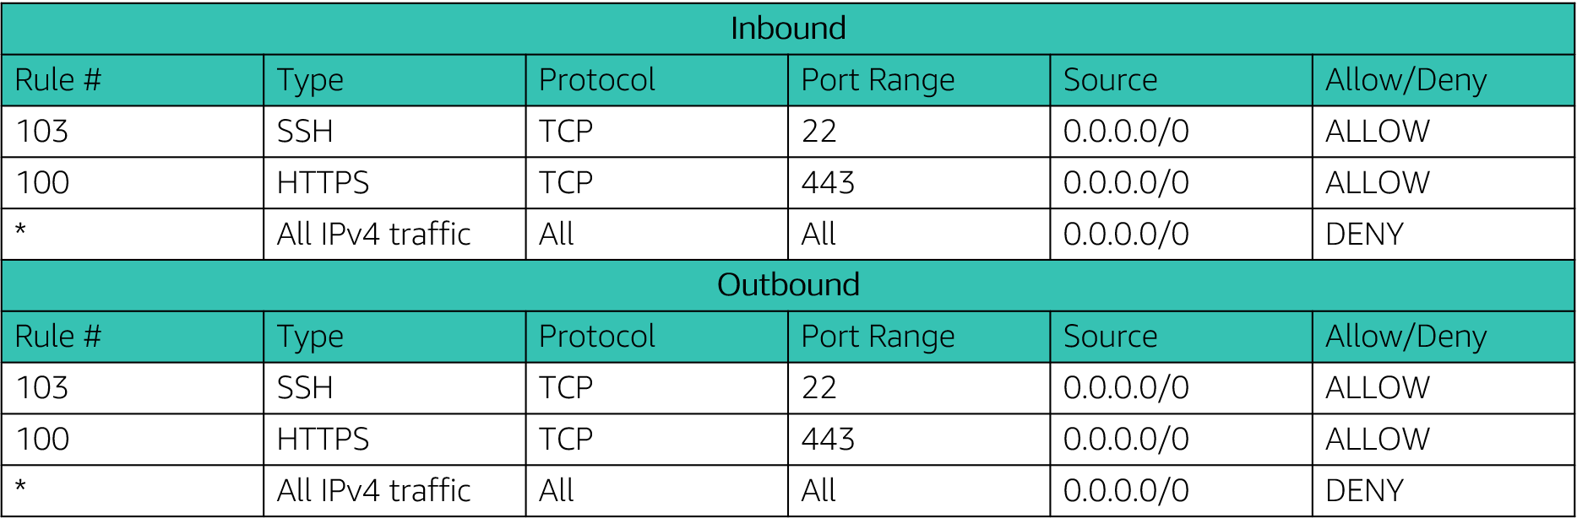
5. Network Access Control Lists (ACLs)

Slide 16
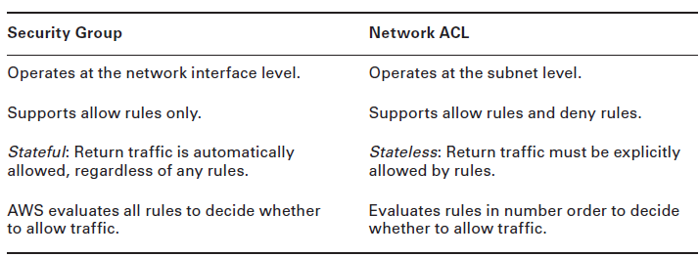
ACLs vs Security Groups

Slide 17
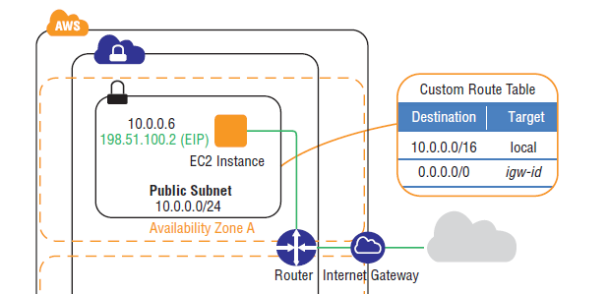
6. Internet Gateways
An Internet gateway is a horizontally-scaled, redundant, and highly available Amazon VPC component that allows communication between instances in your VPC and the Internet. An Internet gateway is a target in your VPC route tables for internet-routable traffic.
You must do the following to create a public subnet with Internet access:
Create and attach an Internet gateway to your VPC.
Create a route in the associated subnet route table to send non-local traffic (0.0.0.0/0 for IPv4 or ::/0 for IPv6) to the Internet gateway.
Configure your network ACLs and security group rules to allow relevant traffic to flow to and from your instance.
You must do the following to enable an Amazon EC2 instance to send and receive traffic from the Internet:
Assign a public IPv4 or Elastic IP address.

Slide 18
7. Network Address Translation (NAT) Instances and NAT Gateways
Any instance that you launch into a private subnet in a VPC is not able to communicate directly with the Internet through an Internet gateway. That is, the subnet route table includes no routes to an Internet gateway. More importantly, connections originating from outside your VPC cannot reach instances inside your private subnet.
IPv4 instances within private subnets may require outbound access to the Internet
NAT is not supported for IPv6. One of the goals of the IPv6 protocol is to provide end-to-end connectivity.
We have two option
NAT Instances
NAT gateways

Slide 19
7. NAT Instances
A NAT instance is an Amazon Linux Amazon Machine Image (AMI) that is designed to accept traffic from instances within a private subnet, translate the source IPv4 addresses to the private IPv4 address of the NAT instance, and forward the traffic to the Internet gateway where one-to-one NAT is performed to a public IPv4 address.
To allow instances within a private subnet to access Internet resources through the Internet gateway via a NAT instance, you must do the following: (NAT instances are managed by you.)
Create a security group for the NAT instance with outbound rules that specify the needed Internet resources by port, protocol, and IP address.
Launch an Amazon Linux NAT AMI as an instance in a public subnet and associate it with the NAT security group.
Disable the Source/Destination Check attribute of the NAT instance.
If you did not launch your NAT instance with a public IPv4 address, allocate an Elastic IP address and associate it with the NAT instance.
Configure the route table associated with the private subnet to direct Internet-bound traffic to the NAT instance (for example, i-1a2b3c4d ).
Used to enable private subnet instances to access the Internet.
NAT instances must be in a single public subnet.
NAT instances need to be assigned to security groups

Slide 20
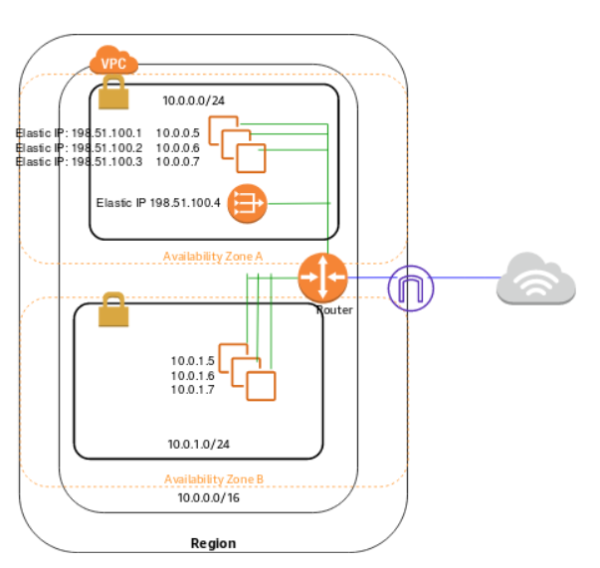
7. NAT Gateways
A NAT gateway is an AWS-managed resource that is designed to operate just like a NAT instance but is simpler to manage and highly available within an Availability Zone.
To allow instances within a private subnet to access Internet resources via a NAT gateway, you must do the following:
Allocate and associate an IPv4 Elastic IP address with a NAT gateway.
Configure the route table associated with the private subnet
to direct Internet- bound traffic to the NAT gateway
for example, nat-1a2b3c4d
NAT gateways are managed for you by AWS.
NAT gateways are highly available in each AZ into which they are deployed.
They are preferred by enterprises. Can scale automatically up to 45Gbps.
Create a NAT gateway in a public subnet.
No need to patch.
Not associated with any security groups.

Slide 21
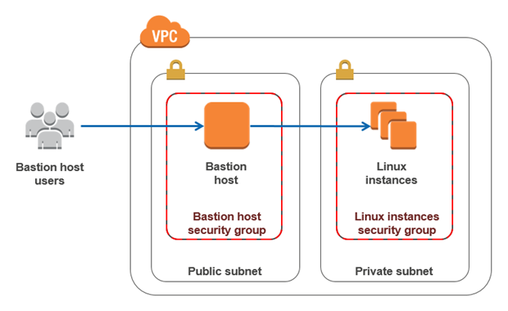
Bastion Host
It is architecture solution.
A bastion host is a server whose purpose is to provide access to a private network from an external network, such as the Internet. Because of its exposure to potential attack, a bastion host must minimize the chances of penetration.
Amazon VPC enables you to launch AWS resources on a virtual private network that you have defined. The bastion host runs on an Amazon EC2 instance that is typically in a public subnet of your Amazon VPC. Linux instances are in a subnet that is not publicly accessible, and they are set up with a security group that allows SSH access from the security group attached to the underlying EC2 instance running the bastion host. Bastion host users connect to the bastion host to connect to the Linux instances
What is the difference between bastion host and NAT instance?
A bastion host allows inbound access to known IP addresses and authenticated users, a NAT instance allows instances within your VPC to go out to the internet.

Slide 22
8. Egress Only Internet Gateways (EIGWs)
One of the goals of the IPv6 protocol is to provide end-to-end connectivity. As such, Amazon does not support NAT for IPv6.
Each instance that is enabled for IPv6 packet processing has at least one GUA. As the name implies, these addresses are unique and global in scope and are public, routable IPv6 addresses.
In order to provide a semantically similar experience to NAT for IPv6, Amazon created the egress-only Internet gateway (EIGW) . The EIGW is a horizontally-scaled, redundant, and highly-available
Unlike a NAT instance or a NAT gateway, the EIGW performs no address translation function.
Notes:
You probably have Amazon EC2 instances that should not be accessible from the Internet. With IPv4, this protection is accomplished in your VPC by creating a private subnet with a NAT instance or NAT gateway.
GUA : Global Unicast addresses : globally routable and reachable in the IPv6 Internet

Slide 23
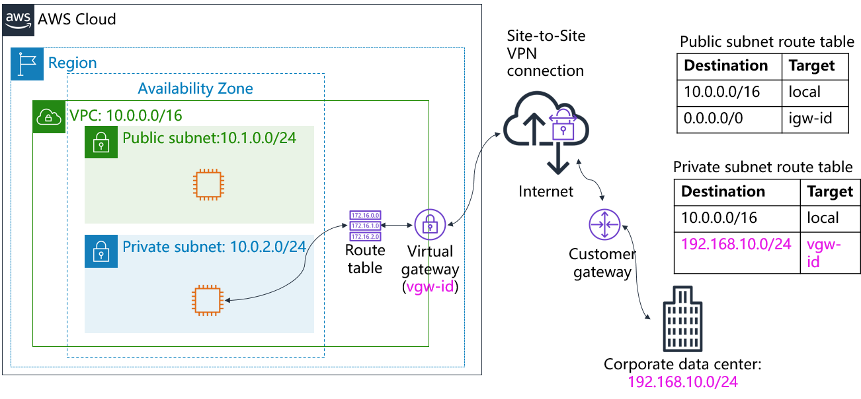
9. Virtual Private Gateways (VGWs),Customer Gateways, and Virtual Private Networks (VPNs)
By default, instances that you launch into a VPC cannot communicate with a remote network. To connect your VPC to your remote network (that is, create a virtual private network or VPN connection)
Create a new virtual gateway device (called a virtual private network (VPN) gateway) and attach it to your VPC.
Define the configuration of the VPN device or the customer gateway. The customer gateway is not a device but an AWS resource that provides information to AWS about your VPN device.
Create a custom route table to point corporate data center-bound traffic to the VPN gateway. You also must update security group rules.
Establish an AWS Site-to-Site VPN (Site-to-Site VPN) connection to link the two systems together.
Configure routing to pass traffic through the connection.

Slide 24
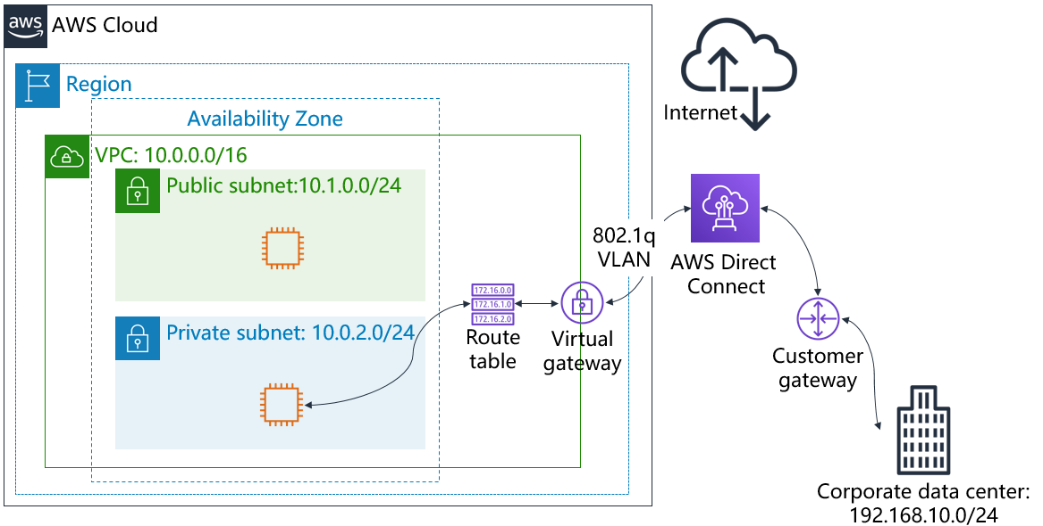
9. Direct Connect
AWS Direct Connect is a network service that provides an alternative to using the Internet to connect a customer’s on-premise sites to AWS.
Data is transmitted through a private network connection between AWS and a customer’s datacenter or corporate network.
Benefits:
• Reduce cost when using large volumes of traffic
• Increase reliability (predictable performance)
• Increase bandwidth (predictable bandwidth)
• Decrease latency
Each AWS Direct Connect connection can be configured with one or more virtual interfaces (VIFs).
Public VIFs allow access to public services such as S3, EC2 and DynamoDB.
Private VIFs allow access to your VPC.
From Direct Connect you can connect to all AZs within the region.
You can establish IPSec connections over public VIFs to remote regions.
Direct Connect is charged by port hours and data transfer. Available in 1Gbps and 10Gbps.
Speeds of 50Mbps, 100Mbps, 200Mbps, 300Mbps, 400Mbps, and 500Mbps can be purchased through AWS Direct Connect Partners.

Slide 25
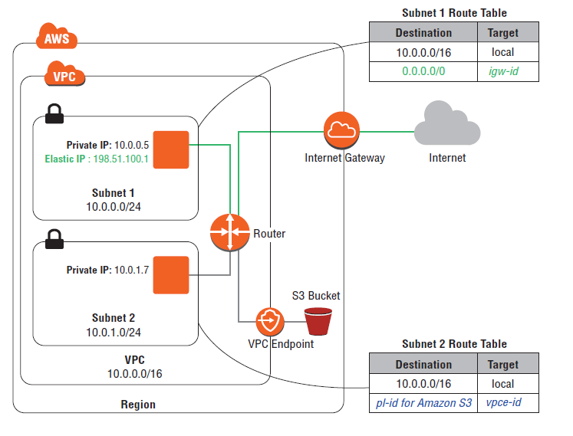
10. VPC Endpoints
A VPC endpoint enables you to connect your VPC privately to supported AWS services and VPC endpoint services (powered by AWS PrivateLink) without requiring an Internet gateway, NAT device, VPN connection, or AWS Direct Connect connection.
VPC endpoints are horizontally-scaled, redundant, and highly available.
There are two types of VPC endpoints:
Interface
Gateway.
Interface endpoints (powered by AWS PrivateLink) use an elastic network interface in your VPC with a private IP address that serves as an entry point for traffic destined to a supported service. Gateway endpoints use a route table target for a specified route in your route table for supported services. Interface endpoints support Amazon Kinesis Streams, Elastic Load Balancing API, Amazon EC2 API, Amazon EC2 Systems Manager (SSM), AWS Service Catalog
Gateway endpoints currently support communication with Amazon Simple Storage Service (Amazon S3) and Amazon DynamoDB.

Slide 26
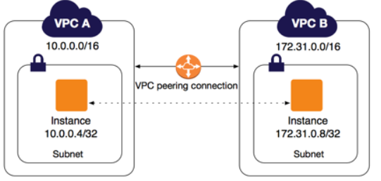
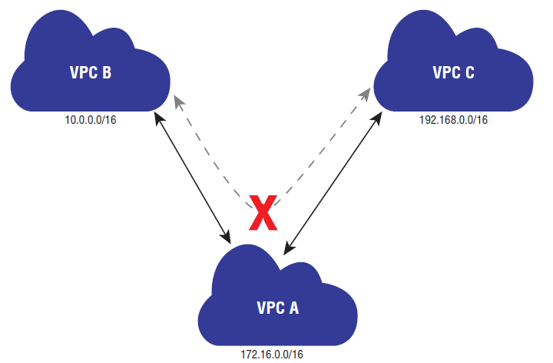
11. VPC Peering
A VPC peering connection is a networking connection between two VPCs that enables you to route traffic between them privately.
Instances in either VPC can communicate with each other as if they are within the same network.
You can create a VPC peering connection between your own VPCs, with a VPC in another AWS account, or with a VPC in a different AWS Region.
VPC peering has some restrictions:
IP address ranges cannot overlap.
Transitive peering is not supported. For example, suppose that you have three VPCs: A, B, and C. VPC A is connected to VPC B, and VPC A is connected to VPC C. However, VPC B is not connected to VPC C implicitly. To connect VPC B to VPC C, you must explicitly establish that connectivity.
You can only have one peering resource between the same two VPCs.

Slide 27
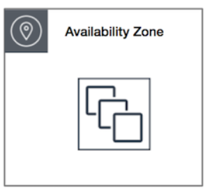
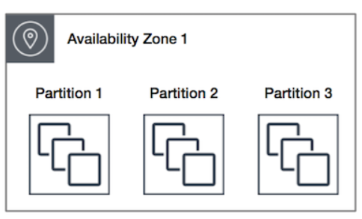
12. Placement Groups
Placement groups are logical groupings of instances within a single Availability Zone.
Instances in the placement group are proximate in the Amazon network infrastructure, delivering low latency,
high packet-per-second performance, and high network throughput.
You can create a placement group using one of the following placement strategies:
Cluster – packs instances close together typical of HPC applications.
Partition – spreads your instances across logical partitions such that groups of typically used by large distributed and replicated workloads, such as Hadoop, Cassandra, and Kafka.
Spread – strictly places a small group of instances across distinct underlying hardware to reduce correlated failures.
The following instance types are supported:
Current generation instances, except for burstable performance instances (for example, T2) and Mac1 instances.
The following previous generation instances: A1, C3, cc2.8xlarge, cr1.8xlarge, G2, hs1.8xlarge, I2, and R3.

Slide 28
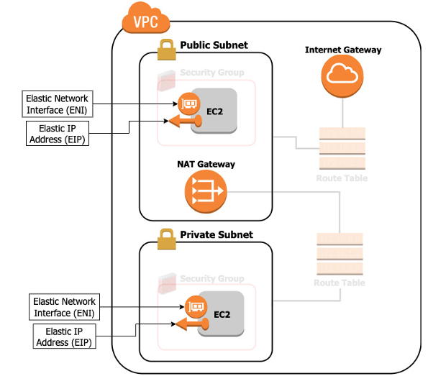
13. Elastic Network Interfaces
An elastic network interface is a virtual network interface that you can:
Attach to an instance.
Detach from the instance, and attach to another instance to redirect network traffic.
Its attributes follow when it is reattached to a new instance.
Each instance in your VPC has a default network interface that is assigned a private IPv4 address from the IPv4 address range of your VPC.
Can attach during to hot( working),warm( stopped),cold (is being lunched)

Slide 29
14. Dynamic Host Configuration Protocol (DHCP) Option Sets
Dynamic Host Configuration Protocol (DHCP) is a standard for passing configuration information to hosts on an IP network. The options field of a DHCP message contains the configuration parameters. Some of those parameters are the domain name, domain name server, and the NetBIOS node type.
AWS automatically creates and associates a DHCP option set for your VPC upon creation and sets two options:
domain-name-servers: This defaults to AmazonProvidedDNS.
domain-name: This defaults to the internal Amazon domain name for your region.
AmazonProvidedDNS is the Amazon DNS server. Amazon DNS, when enabled, allows Amazon EC2 instances to resolve domain names for destinations on the Internet and in a VPC peer in the same region.
The DHCP option sets of a VPC allow you to change how host and domain names are assigned to your Amazon EC2 resources. To assign your own domain name to your instances, create a custom DHCP option set and assign it to your VPC. You can configure the following values within a DHCP option set:
domain-name-servers: The IP addresses of up to four domain name servers, separated by commas.
domain-name: Specify the desired domain name (for example, mycompany.com).
ntp-servers: The IP addresses of up to four Network Time Protocol (NTP) servers,separated by commas.
netbios-name-servers: The IP addresses of up to four NetBIOS name servers, separated by commas.
Each VPC must have exactly one DHCP option set assigned to it.

Slide 30
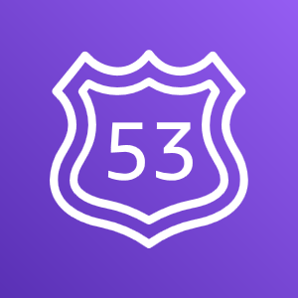
15. Amazon Domain Name Service (DNS) Server Amazon Route 53
Amazon Route 53
Is a highly available and scalable Domain Name System (DNS) web service
Is used to route end users to internet applications by translating names (like www.example.com) into numeric IP addresses (like 192.0.2.1) that computers use to connect to each other
Is fully compliant with IPv4 and IPv6
Connects user requests to infrastructure running in AWS and also outside of AWS
Is used to check the health of your resources
Features traffic flow
Enables you to register domain names

Slide 31
15. Amazon Domain Name Service (DNS) Server Amazon Route 53
Amazon Route 53
Simple routing – Use in single-server environments
Weighted round robin routing – Assign weights to resource record sets to specify the frequency
Latency routing – Help improve your global applications
Geolocation routing – Route traffic based on location of your users
Geoproximity routing – Route traffic based on location of your resources
Failover routing – Fail over to a backup site if your primary site becomes unreachable
Multivalue answer routing – Respond to DNS queries with up to eight healthy records selected at random

Slide 32
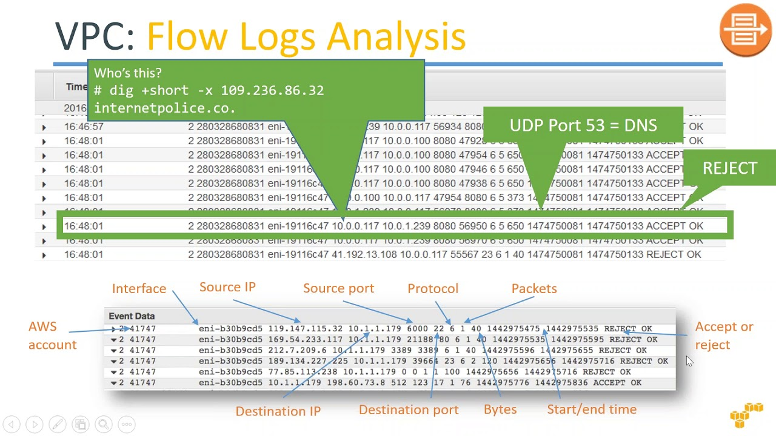
16. VPC Flow Logs
VPC Flow Logs is a feature of Amazon VPC that captures IP traffic flow information in your VPC.
The flow data is stored in Amazon CloudWatch Logs.
VPC Flow Logs can be enabled at the VPC, subnet, or network interface level.
The logs are published approximately every 10 minutes
VPC Flow Logs are useful for a number of reasons, including anomaly detection and troubleshooting

Slide 33

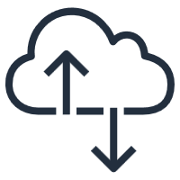


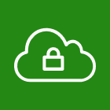



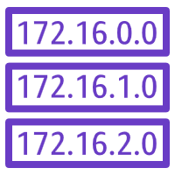


Label this network diagram
AWS Cloud
?
?
?
Public subnet:10.0.1.0/24
?
?
Internet
?
_?_ IP address
Q6
?
Destination | Target
? | local
0.0.0.0/0 | ?
Private subnet: 10.0.2.0/24
?
?
?
_?_ IP address
10.0.0.0/16
Notes:
See if you can recognize the different VPC networking components that you learned about by labeling this network diagram.

Slide 34
Solution
AWS Cloud
Region
Availability Zone
VPC
Public subnet:10.0.1.0/24
Public subnet
Internet gateway
Route table
Internet
Private IP address
NAT gateway
Route
Destination | Target
10.0.0.0/16 | local
0.0.0.0/0 | igw-id
Private subnet
Private subnet: 10.0.2.0/24
Route table
Elastic network interface
Private IP address
10.0.0.0/16
Notes:
Now, see how well you did.

Slide 35
Questions ?
Q1: What is the scope of an Amazon VPC?
A. A data center
B. A region
C. An availability zone
D. A subnet
Q2: Which type of firewall operates at the instance level?
A. A security group
B. A network access control list (NACL)
C. A route table
D. A NAT Gateway
Q3: How can an organization create a private hybrid cloud connection between their on-premises data center and the AWS Cloud?
A. AWS managed VPN
B. VPN CloudHub
C. Software VPN
D. AWS Direct Connect
Q4: Which type of public IP address is retained when the instance is stopped?
A. Public IP address
B. Private IP address
C. Elastic IP address
D. Local IP address
Q5: Which AWS-managed network service can be used to enable Internet connectivity for EC2 instances in private subnets?
A. NAT Instance
B. NAT Gateway
C. Internet Gateway
D. Network ACL

Slide 36
Questions ?
Q1: What is the scope of an Amazon VPC?
A. A data center
B. A region
C. An availability zone
D. A subnet
Q2: Which type of firewall operates at the instance level?
A. A security group
B. A network access control list (NACL)
C. A route table
D. A NAT Gateway
Q3: How can an organization create a private hybrid cloud connection between their on-premises data center and the AWS Cloud?
A. AWS managed VPN
B. VPN CloudHub
C. Software VPN
D. AWS Direct Connect
Q4: Which type of public IP address is retained when the instance is stopped?
A. Public IP address
B. Private IP address
C. Elastic IP address
D. Local IP address
Q5: Which AWS-managed network service can be used to enable Internet connectivity for EC2 instances in private subnets?
A. NAT Instance
B. NAT Gateway
C. Internet Gateway
D. Network ACL

Slide 37
Questions ?
Q1: What is the scope of an Amazon VPC?
A. A data center
B. A region
C. An availability zone
D. A subnet
Q2: Which type of firewall operates at the instance level?
A. A security group
B. A network access control list (NACL)
C. A route table
D. A NAT Gateway
Q3: How can an organization create a private hybrid cloud connection between their on-premises data center and the AWS Cloud?
A. AWS managed VPN
B. VPN CloudHub
C. Software VPN
D. AWS Direct Connect
Q4: Which type of public IP address is retained when the instance is stopped?
A. Public IP address
B. Private IP address
C. Elastic IP address
D. Local IP address
Q5: Which AWS-managed network service can be used to enable Internet connectivity for EC2 instances in private subnets?
A. NAT Instance
B. NAT Gateway
C. Internet Gateway
D. Network ACL

Slide 38
Questions ?
Q1: What is the scope of an Amazon VPC?
A. A data center
B. A region
C. An availability zone
D. A subnet
Q2: Which type of firewall operates at the instance level?
A. A security group
B. A network access control list (NACL)
C. A route table
D. A NAT Gateway
Q3: How can an organization create a private hybrid cloud connection between their on-premises data center and the AWS Cloud?
A. AWS managed VPN
B. VPN CloudHub
C. Software VPN
D. AWS Direct Connect
Q4: Which type of public IP address is retained when the instance is stopped?
A. Public IP address
B. Private IP address
C. Elastic IP address
D. Local IP address
Q5: Which AWS-managed network service can be used to enable Internet connectivity for EC2 instances in private subnets?
A. NAT Instance
B. NAT Gateway
C. Internet Gateway
D. Network ACL

Slide 39
Questions ?
Q1: What is the scope of an Amazon VPC?
A. A data center
B. A region
C. An availability zone
D. A subnet
Q2: Which type of firewall operates at the instance level?
A. A security group
B. A network access control list (NACL)
C. A route table
D. A NAT Gateway
Q3: How can an organization create a private hybrid cloud connection between their on-premises data center and the AWS Cloud?
A. AWS managed VPN
B. VPN CloudHub
C. Software VPN
D. AWS Direct Connect
Q4: Which type of public IP address is retained when the instance is stopped?
A. Public IP address
B. Private IP address
C. Elastic IP address
D. Local IP address
Q5: Which AWS-managed network service can be used to enable Internet connectivity for EC2 instances in private subnets?
A. NAT Instance
B. NAT Gateway
C. Internet Gateway
D. Network ACL

Slide 40
Questions ?
Q1: What is the scope of an Amazon VPC?
A. A data center
B. A region
C. An availability zone
D. A subnet
Q2: Which type of firewall operates at the instance level?
A. A security group
B. A network access control list (NACL)
C. A route table
D. A NAT Gateway
Q3: How can an organization create a private hybrid cloud connection between their on-premises data center and the AWS Cloud?
A. AWS managed VPN
B. VPN CloudHub
C. Software VPN
D. AWS Direct Connect
Q4: Which type of public IP address is retained when the instance is stopped?
A. Public IP address
B. Private IP address
C. Elastic IP address
D. Local IP address
Q5: Which AWS-managed network service can be used to enable Internet connectivity for EC2 instances in private subnets?
A. NAT Instance
B. NAT Gateway
C. Internet Gateway
D. Network ACL

